Slide 1
National and international standard systems
AAMI EQ56
MHRA ‘Managing medical devices’ guidance bulletin
ISO 9001:2000
Relevance to a workshop in a Zambian hospital
17.5.5 Identify national and international management standards and relate them to a hospital maintenance workshop.
Unit C 17.5 Adhering to Medical Equipment Standards
Module 279-17-C Regulations, Standards and Ethics
©
dr. Chris R. Mol, BME, NORTEC, 2016

Slide 2
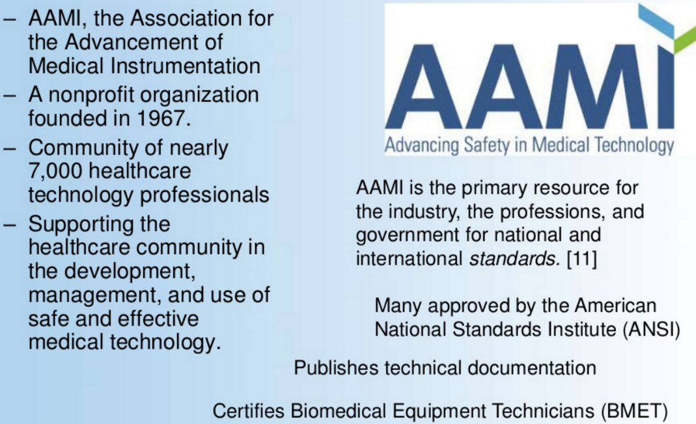
Medical Device standards in the USA: AAMI
Standards for Medical Equipment in the USA
©
Management Standards
dr. Chris R. Mol, BME, NORTEC, 2016

Slide 3
AAMI EQ56: recommended practice for Medical Equipment Management Program
AAMI EQ56 is an American National Standard identifying the key elements of an equipment management program and establishes how these elements should be incorporated in a hospital’s program.
Though this standard is not mandatory in Zambia, it is interesting to learn how the USA approaches this. It could well be part of the future for Zambia.
The basic approach is that many ways of doing things regarding medical equipment in a hospital are not just optional, a good idea, but are part of a professional system that underpins safety and effectivity in the hospital.
All hospitals are different. Therefore, AAMI EQ65 does not mandate a single level of activity for each hospital.
Its main philosophy is: ‘say what you do, and then do what you say’
©
Management Standards
dr. Chris R. Mol, BME, NORTEC, 2016

Slide 4
AAMI EQ56: selection of recommendations
EQ56 on Equipment Inventory:
A hospital must maintain an equipment inventory
it must be defined what equipment goes into the inventory and what not
certain ‘fields’ are obligatory in the inventory (e.g. id number, manufacturer, location, etc.)
certain fields are optional (e.g. acquisition cost, estimated useful life, warranty expiration, etc.)
the inventory must be accurate – in line with reality
the inventory must be audited yearly (by checking a random selection of equipment)
EQ56 on Inspection and Repair Procedures
There must be descriptions that state what a technician is expected to do when inspecting a device; per device.
Each inspection procedure must include the estimate of the time required to perform that procedure
There must be a list of (service) documents that are required for maintenance.
There must be a description on how documentation regarding equipment repair is kept/archived
©
Management Standards
dr. Chris R. Mol, BME, NORTEC, 2016

Slide 5
AAMI EQ56: selection of recommendations
EQ5: other selected Recommendations
Training for each BMET is required to be at least 72 hours over a 3 year period.
Training for a new employee is at least 36 hours in the first year.
There must be procedures describing acceptance testing; including communication with users on arrival of shipment and on installation
Inspection intervals per equipment should be listed and verified
Required number of (BMET) staff should be identified, adequate for maintenance tasks
Adequate workshop space must be allocated
Space to store unused equipment should be identified
Financial management: budgets must be established
Test equipment must be defined
Incident Investigation must be executed with qualified persons
©
Management Standards
dr. Chris R. Mol, BME, NORTEC, 2016

Slide 6
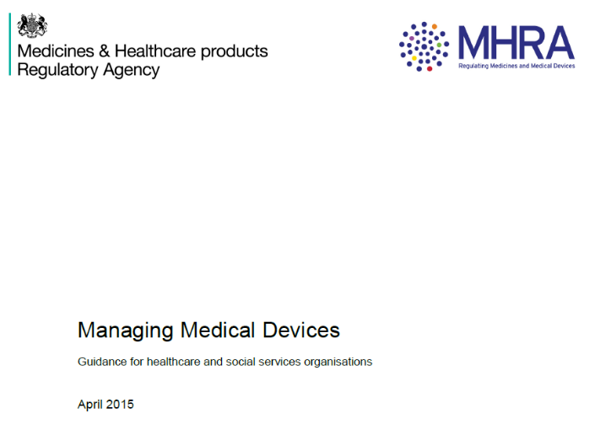
MHRA: Medical Device Management in the UK
The Medicines and Healthcare Products Regulatory Agency (MHRA) is an executive agency of the Department of Health in the United Kingdom which is responsible for ensuring that medicines and medical devices work and are acceptably safe.
https://www.gov.uk/government/organisations/medicines-and-healthcare-products-regulatory-agency
The ‘Managing medical devices’ bulletin describes required ways of managing medical equipment in the UK
©
Management Standards
dr. Chris R. Mol, BME, NORTEC, 2016

Slide 7
MHRA on Management Responsibility
Healthcare organisations should appoint a director or board member with overall responsibility for medical device management.
There should be systems in place to ensure reporting of device issues including:
the effectiveness of the medical devices management system
the condition and performance of medical devices including: device failures and issues; utilisation, performance, maintenance; repair and calibration history
the execution of investment, replacement and disposal plans.
Healthcare organisations should appoint Medical Device Safety Officers (MDSO) or equivalent.
Part of the MDSO role is to report adverse incidents to the MHRA and other official agencies.
Healthcare organisations should set out a long term approach and objectives for the management of their medical devices, including strategic replacement and development equipment procurement planning.
©
Management Standards
dr. Chris R. Mol, BME, NORTEC, 2016

Slide 8
MHRA: Medical devices management group
Healthcare organisations should establish a medical devices management group to develop and implement policies across the organisation.
Membership of the group should depend on the requirements of each healthcare organisation, but needs to be broad enough to address all the policy areas. It needs appropriate representation from among the following groups of staff:
• clinical
• clinical / biomedical engineering
• management
• infection control
• decontamination lead
• risk management
• engineering
• maintenance
• purchasing
• medical device trainers
• medical device users
• MDSOs
The group’s role should be to:
• improve communication about medical devices within the organisation
• ensure involvement of clinicians, technical staff and users in relation to any proposed changes, where appropriate
• define persons responsible for device management tasks, training and safe device operation
• define and review the device management policy
• review incidents including governance issues relating to medical device management.
©
Management Standards
dr. Chris R. Mol, BME, NORTEC, 2016

Slide 9
MHRA: Reporting adverse incidents
An adverse incident is an event that causes, or has the potential to cause, unexpected or unwanted effects involving the safety of patients, users or other persons. Any known problems associated with product design, documentation and common use related issues should also be reported, for follow up.
Reporting is essential to ensure that lessons are learned and adverse events are not repeated.
National reporting is essential to ensure that trends are spotted and appropriate action is taken across the country to help ensure the safe and effective use of medical devices, for example through safety warnings. Unless the MHRA receives reports of all adverse events, emerging problems cannot be identified, continuing the risk of repeat events and patient harm.
Information from adverse incident reporting indicates that one of the factors that has the greatest impact on the safety of devices involve the instructions for use issued by the manufacturer, their availability and clarity. Other key safety factors include the design, the quality of training in the appropriate uses of devices and how well they are maintained and prepared.
©
Management Standards
dr. Chris R. Mol, BME, NORTEC, 2016

Slide 10
MHRA: Maintenance and repair
The healthcare organisation’s medical device management policy must cover the provision of maintenance and repair of all medical devices. The healthcare organisation is responsible for ensuring their medical devices are maintained appropriately.
This includes:
How each device should be maintained and repaired, and by whom
Arrangements for maintenance and repair to be included as part of the assessment process
Arrangements for the most suitable persons/providers to carry out the work
Arrangements to ensure items subject to inspection, maintenance, repair or disposal should be decontaminated beforehand
The timescale for planned maintenance
The timescale for repairs to be completed
The frequency and type of planned preventive maintenance should be specified, in line with the manufacturer’s instructions and taking
©
Management Standards
dr. Chris R. Mol, BME, NORTEC, 2016

Slide 11
MHRA: Decommissioning
Decommissioning aims to make devices safe and unusable, while minimising damage to the environment. Any device deemed unfit for use should be decommissioned.
It is advisable to contact the manufacturer for information on decommissioning. The manufacturer should be able to provide details of any environmental, disposal, recycling or structural requirements.
Decommissioning should include decontamination, making safe and making unusable. This is to ensure that an inappropriate person does not use the device and expose themselves and / or others to hazards.
For devices that are mobile or housed in general facilities, safety checks, such as power disconnection and cooling system disconnection, should be carried out.
Decommissioning larger installations often involves removal from a purpose-built room or surroundings. Decommissioning of device incorporating radioactive sources must be carried out in accordance with the Ionising Radiations Regulations.
If a device stores patient identifiable data, this should be certified as securely erased before disposal. Data on any device should be forensically unrecoverable, i.e. patient data must be over-written.
©
Management Standards
dr. Chris R. Mol, BME, NORTEC, 2016

Slide 12
MHRA: Guidance available
on the following topics
Monitoring /audit
Records
Reporting adverse incidents
Actions required on the MHRA Medical Device Alerts
Acquiring the most appropriate device and rationalisation
Equipment life cycle
Technical specification
Acceptance procedures for newly delivered devices
Maintenance and repair
Training
Equipment inventory
Adequacy of manufactures instruction
Prescribing the best device
Decontamination
Risk management
Transfer of ownership
Regulatory compliances and related issues
Legal liabilities
Decommissioning
Disposal
©
Management Standards
dr. Chris R. Mol, BME, NORTEC, 2016

Slide 13
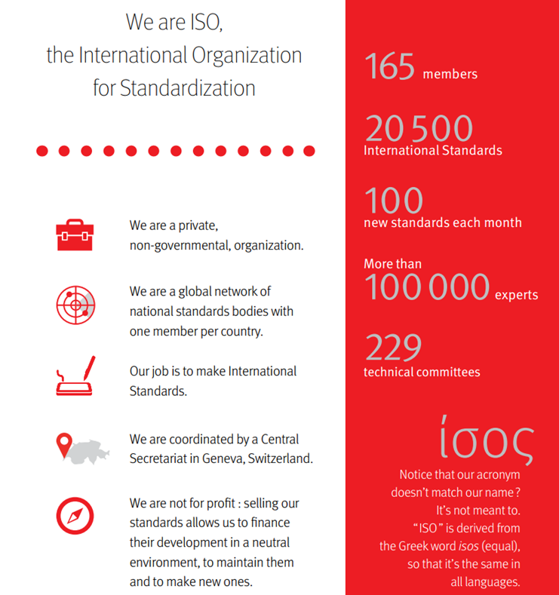
Who is ISO ?
ISO is an independent, non-governmental international organization with a membership of 161 national standards bodies. Through its members, it brings together experts to share knowledge and develop voluntary, consensus-based, market relevant International Standards that support innovation and provide solutions to global challenges.
ISO has published more than 19000 International Standards and related documents, covering almost every industry, from technology, to food safety, to agriculture and healthcare. ISO International Standards impact everyone, everywhere.
more on http://www.iso.org/iso/home.html
©
Government Regulatory Agencies
dr. Chris R. Mol, BME, NORTEC, 2016
©

Slide 14
ISO 9001:2015, the Quality Management standard
The ISO 9001 standard is based on a number of quality management principles including:
a strong customer focus,
the motivation and implication of top management,
the process approach and
continual improvement.
Using ISO 9001:2015 helps ensure that customers get consistent, good quality products and services, which in turn brings many business benefits.
All requirements of this International Standard are generic and are applicable to all organizations, regardless of type, size and product provided.
An organization can be ‘ISO 9001:2015 certified’.
This gives customers confidence that this is a ‘well-managed’ company. In fact, there are over one million companies and organizations in over 170 countries certified to ISO 9001.
©
Management Standards
dr. Chris R. Mol, BME, NORTEC, 2016

Slide 15
Quality System Principles from ISO 9001
ISO 9001, first issued in 1987, and revised several times since then, is unlike Good Manufacturing Practices (GMP).
It focuses on business management standards (‘processes’) rather than the product itself.
By addressing the common problems businesses face at their source, and continuously seeking improvement, it allows product quality assurance.
Checking that the system works is a vital part of ISO 9001.
It is recommended that an organization performs internal audits to check how its quality management system is working. An organization may decide to invite an independent certification body to verify that it is in conformity to the standard, but there is no requirement for this. Alternatively, it might invite its clients to audit the quality system for themselves.
In this lecture the Principles behind ISO 9001 are discussed
©
Management Standards
dr. Chris R. Mol, BME, NORTEC, 2016

Slide 16
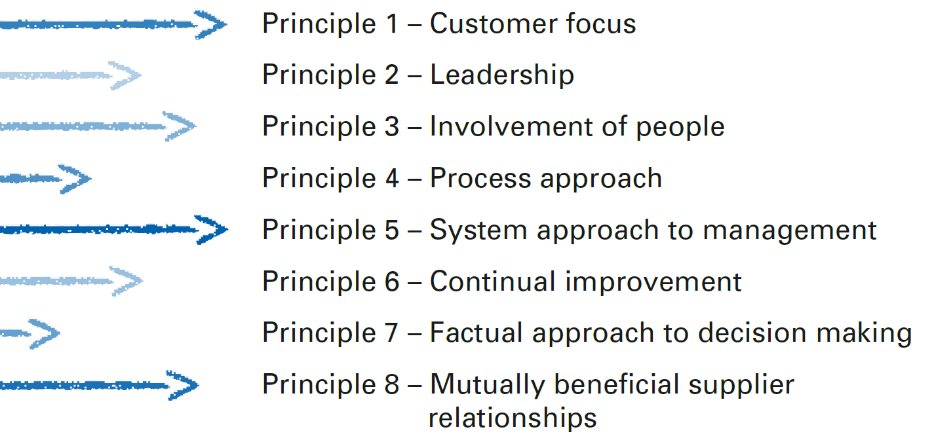
Quality System Principles from ISO 9001
©
Management Standards
dr. Chris R. Mol, BME, NORTEC, 2016

Slide 17
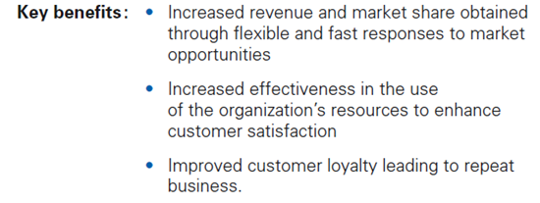
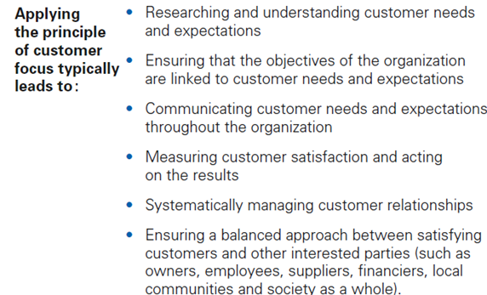
Principle 1 – Customer Focus
©
Management Standards
dr. Chris R. Mol, BME, NORTEC, 2016

Slide 18
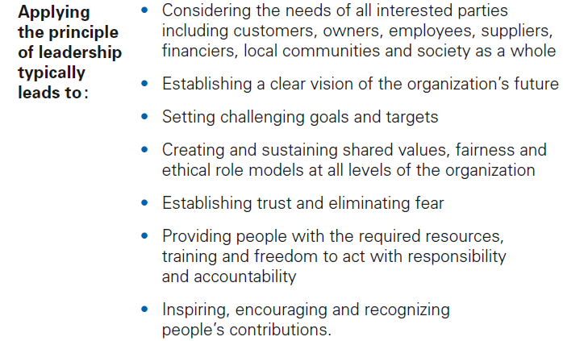
Principle 2 – Leadership
©
Management Standards
dr. Chris R. Mol, BME, NORTEC, 2016

Slide 19
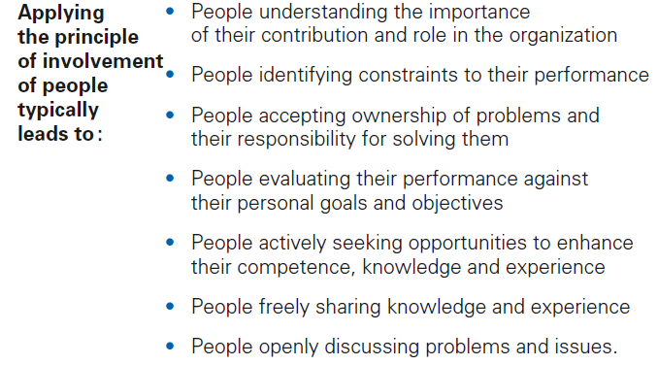
Principle 3 – Involvement of People
©
Management Standards
dr. Chris R. Mol, BME, NORTEC, 2016

Slide 20
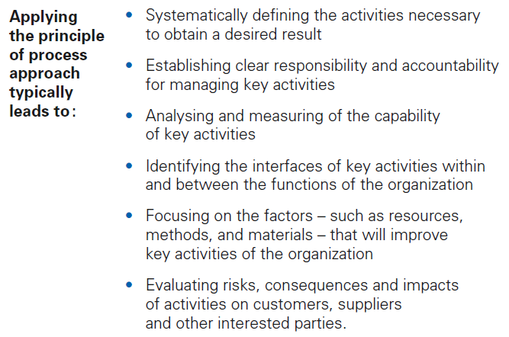
Principle 4 – Process Approach
©
Management Standards
dr. Chris R. Mol, BME, NORTEC, 2016

Slide 21
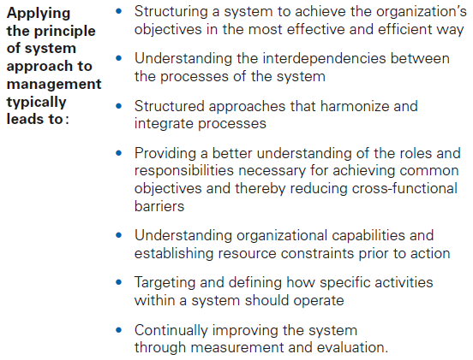
Principle 5 – System approach to management
©
Management Standards
dr. Chris R. Mol, BME, NORTEC, 2016

Slide 22
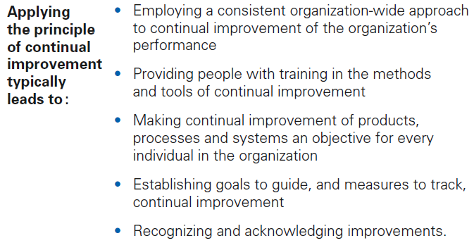
Principle 6 – Continual Improvement
©
Management Standards
dr. Chris R. Mol, BME, NORTEC, 2016

Slide 23
Principle 7 – Factual Approach to Decision Making
©
Management Standards
dr. Chris R. Mol, BME, NORTEC, 2016

Slide 24
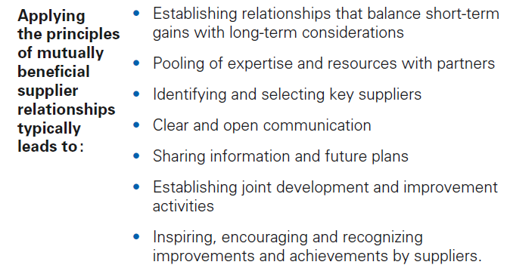
Principle 8 – Mutually Beneficial Supplier Relationships
©
Management Standards
dr. Chris R. Mol, BME, NORTEC, 2016

Slide 25
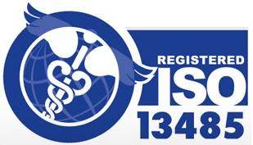
ISO 13485 is ISO 9001 for Medical Equipment manufacturers
While ISO 13485 is based on ISO 9001, there are some key differences and additional requirements, in addition to product-specific demands and more stringent documentation requirements.
ISO 13485 calls for risk management to be in place for all stages of product realization, training and supervision of staff, project site specs, and prevention of contamination.
Clinical evaluation must be carried out as part of design and development evaluation in line with regulatory requirements.
The cleanliness of products and contamination control must be considered, as must the status of the product with respect to monitoring and measurement.
An organization can be
‘ISO 13485 certified’
©
Management Standards
dr. Chris R. Mol, BME, NORTEC, 2016

Slide 26
Relevance to a workshop in a Zambian hospital
Hospital BMET workshop to install ISO 9000 principles ?
customer orientation
target setting (number of functioning equipment)
measurement of output
process descriptions
continuous improvement
BMET association to install guidelines for way of working (MHRA / AAMI) and promote this with MoH
inventory
repair procedures (forms, ..) and analysis
BMET training
procedures for commissioning and decommissioning
etc. ……
In next Lectures
©
Management Standards
dr. Chris R. Mol, BME, NORTEC, 2016

Slide 27
END
The creation of this presentation was supported by a grant from THET:
see https://www.thet.org/

